Slide 1
HOW TO BULID NETWORk
By SHARATH BALAN

Slide 2
Network devices
Modem
Rj-45
nic (Network Interface Card)
Ethernet card
Hub
Router

Slide 3
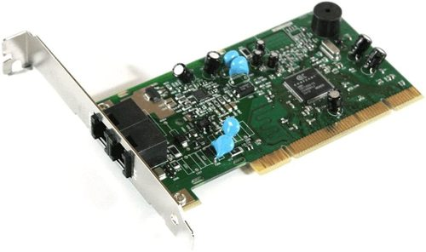
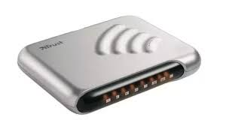
MODEM

Slide 4
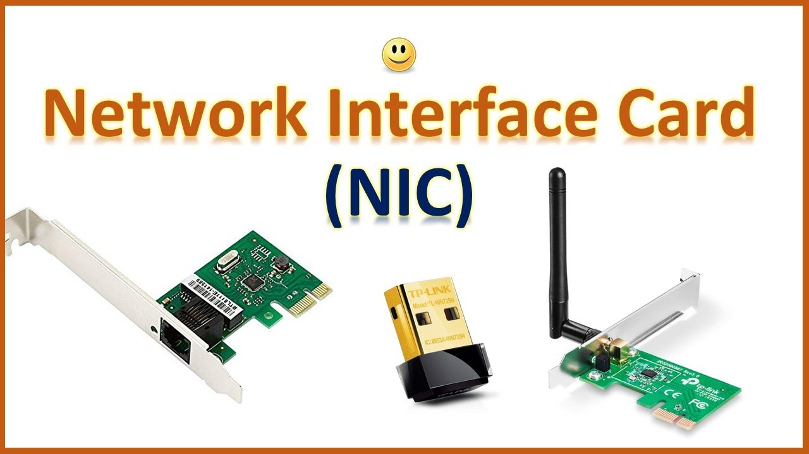

Slide 5
Setting up a home network – components and structure
Router or Wireless router – Connects the network to the Internet.
Wireless Access Point – Used to Connect Wi-Fi equipped devices to the network.
Ethernet HUB or Switch -Used to Connect Ethernet equipped devices.
Cable cat 5, cat5e or cat 6 with RJ45 connectors.
Telephone Cable with RJ 10 connectors.
Broadband Filters.

Slide 6
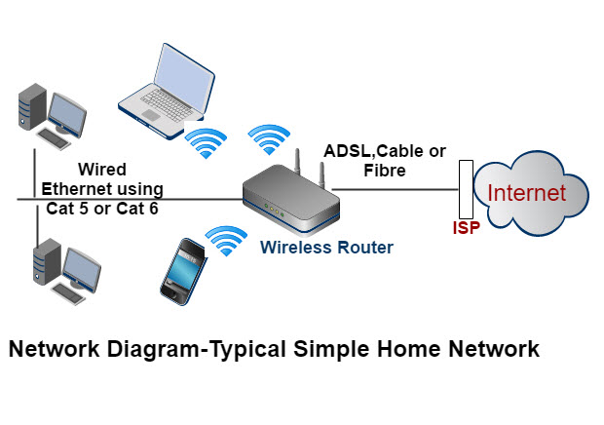

Slide 7
DSL MODem & broadband filter
converts digital signals into analogue signals that are suitable for sending over a telephone line.
Used to filter out DSL signals from telephone signals so that you can access the internet and use the telephone simultaneously. Often included as part of the connection socket.

